Slide 1
Systems of Equations
Section 10.1

Slide 2
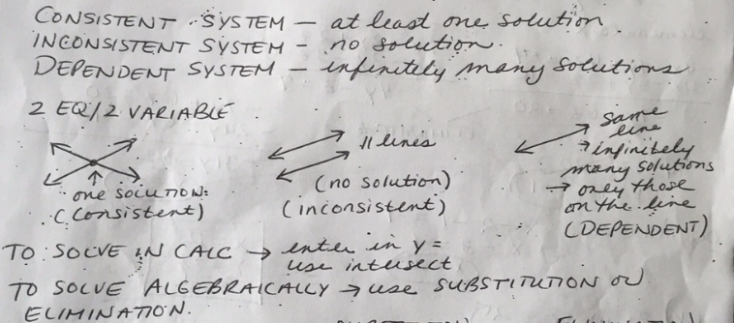
Objective: Solve systems of equations in 2 or 3 variables using the substitution or elimination method.

Slide 3
Ex.1 Solve $\begin{matrix}2x+y=4 \\ −6x−3y=−12\end{matrix}$
Substitution | Elimination

Slide 4
Ex.2 Solve $\begin{matrix}\frac{4}{x}−\frac{3}{y}=0 \\ \frac{6}{x}+\frac{3}{2y}=2\end{matrix}$

Slide 5
3 Equations/3Variables

Slide 6
Ex.3 Solve $\begin{matrix}x+y−z=−1 \\ 4x−3y+2z=16 \\ 2x−2y−3z=5\end{matrix}$

Slide 7
Ex. 4 $\begin{matrix}2x+y−z=−2 \\ x+2y−z=−9 \\ x−4y+z=1\end{matrix}$

Slide 8
Ex.5 $\begin{matrix}x−2y−z=8 \\ 2x−3y+z=23 \\ 4x−5y+5z=53\end{matrix}$

